Slide 1
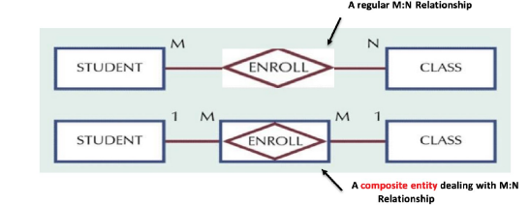
Associative or Composite Entity (Chen notation)
Associative entity (bridge entity, Composite entity) is an entity type that associates the instances of one or more entity types. It contains attributes specific to the relationship between original entity types instances
It builds a bridge between the original entity types
It is composed of the Keys of the original entity types
It may contain additional attributes
It is specific type of a weak entity. It is depicted as a rectangle with a diamond inside.

Slide 2
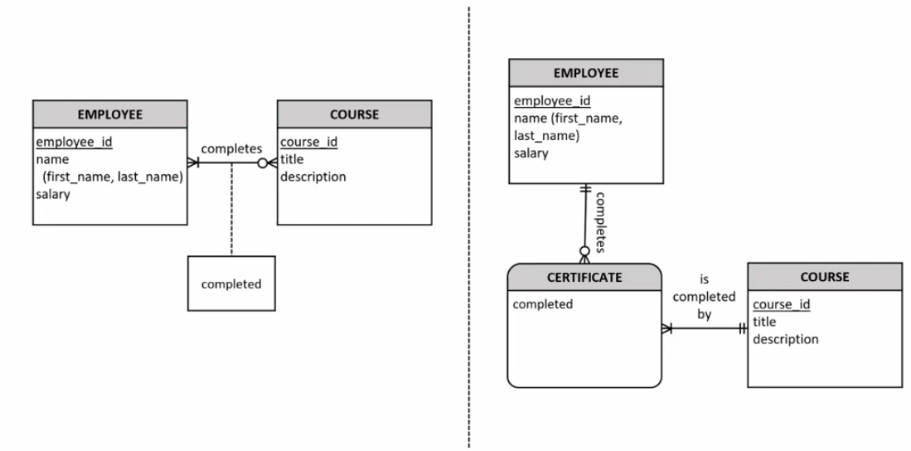
Associative Entity: Binary Relationship with an attribute

Slide 3
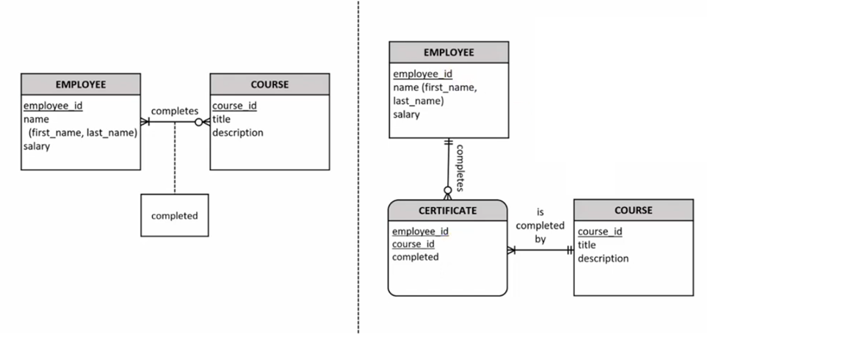
Associative Entity: Binary Relationship with an attribute

Slide 4
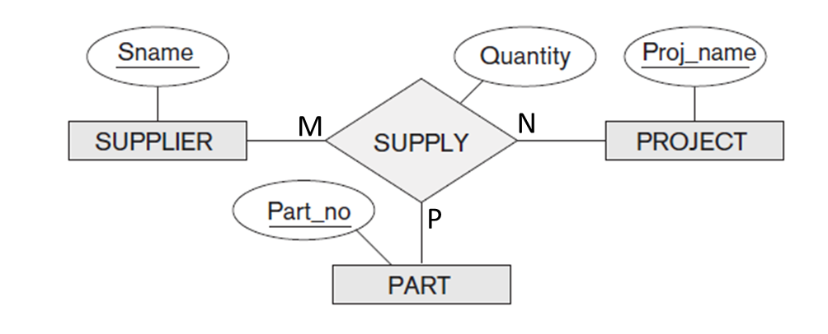
Ternary Relationship Type
Assume that we have a situation where suppliers can supply parts for projects.
A supplier can supply a particular part for multiple projects.
A part for a particular project can be supplied by multiple suppliers.
A project can have a particular supplier supply multiple parts.
The model must also include the quantity for supplying a particular product to a particular project by a particular supplier.

Slide 5

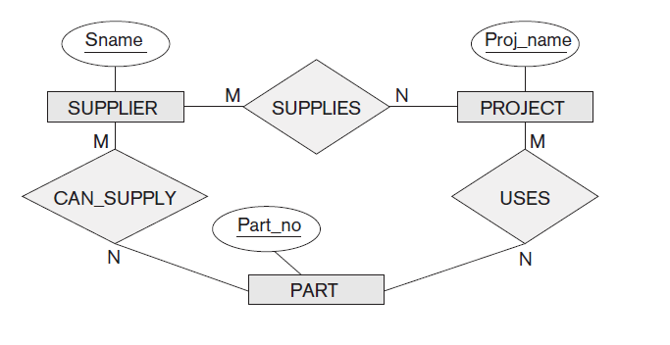
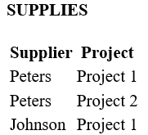

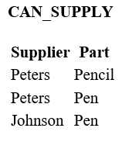
Ternary Relationship Type
Three binary relationships not equivalent to SUPPLY.
Say we have two projects: project 1 uses a pencil and a pen, and project 2 uses a pen. Supplier Peters supplies the pencil for project 1 and the pen for project 2, whereas supplier Johnson supplies the pen for project 1.
From the binary relationship types, it is not clear who supplies the pen for project 1!

Slide 6
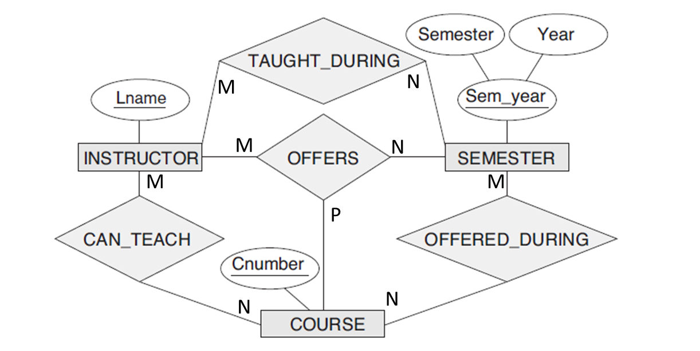
Ternary Relationship Type
If a particular binary relationship can be derived from a higher-degree relationship at all times, then it is redundant
We can infer the instances of TAUGHT_DURING and OFFERED_DURING from the instances in OFFERS, but we cannot infer the instances of CAN_TEACH; therefore, TAUGHT_DURING and OFFERED_DURING are redundant and can be left out.

Slide 7
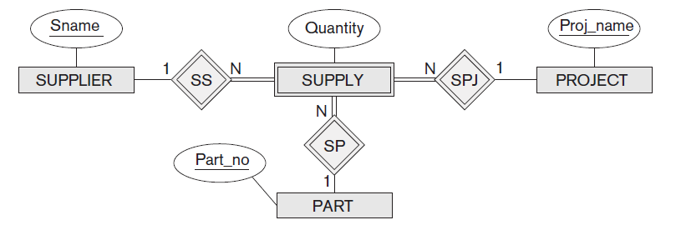
Ternary Relationship Type
SUPPLY can be represented as a weak entity type.
It is also possible to represent the ternary relationship as a regular entity type by introducing an artificial or surrogate key. In this example, a key attribute Supply_id could be used for the supply entity type, converting it into a regular entity type.

